Slide 1
Copado Training User Onboarding
All Users Licensed for the Copado Training should perform steps outlined in the following slides prior to the start of the training

Slide 2
Create Org Credentials (where Copado is installed)
Sign into the training org – tmPROD with your Production username and ad .tmprod at the end.
Like q23s@pge.com.svc.tmprod. The password should be the same as in production, but in case needed, I will reset it for you
In the Apps Launcher search and open Copado Release Manager
Open the Copado Getting Started tab and Navigate to the Org Credentials (See image A & B)
In the Org Name field type Prod-(Your First Name) (See image C)
In the Org Type select Sandbox (See image C) and click on Create. (See image C)
Under the Existing Or Credential section, click on Authenticate (See image D), the new window will launch.
You will be asked to enter your Salesforce training username and password in the login page. (See image E)
Next, you will be asked to allow Copado to access your org. Click on Allow. (See image F)
You will be taken to the Org Credential record, click on Save (See image G)
Go back to the getting started tab and select Account Summary tab (See image H)
Under Account Summary Section Select Create/Reset (See image I)
Select API Key tab (See image J)
Select Create / Reset
You should see an API Key (See image J) - this is the last step to perform.

Slide 3
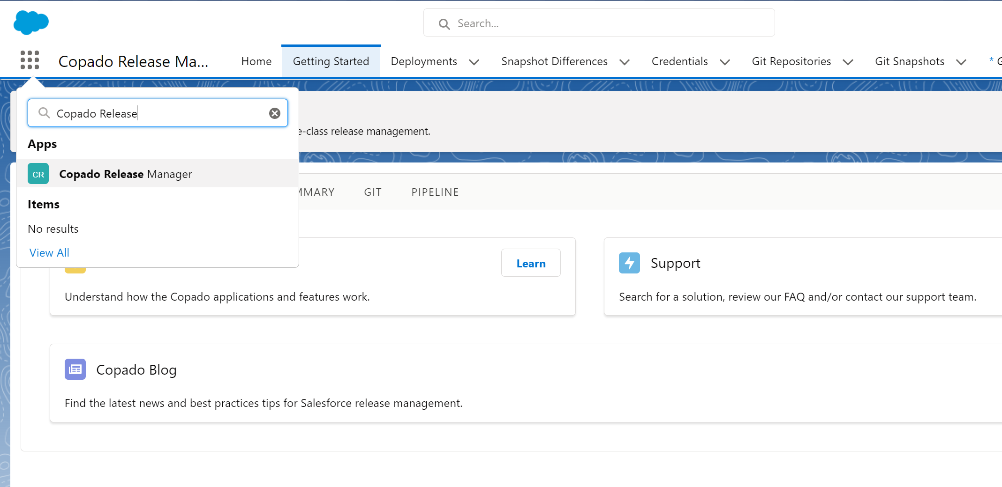

Open the Copado ‘Getting Started’ tab (image A)

Slide 4
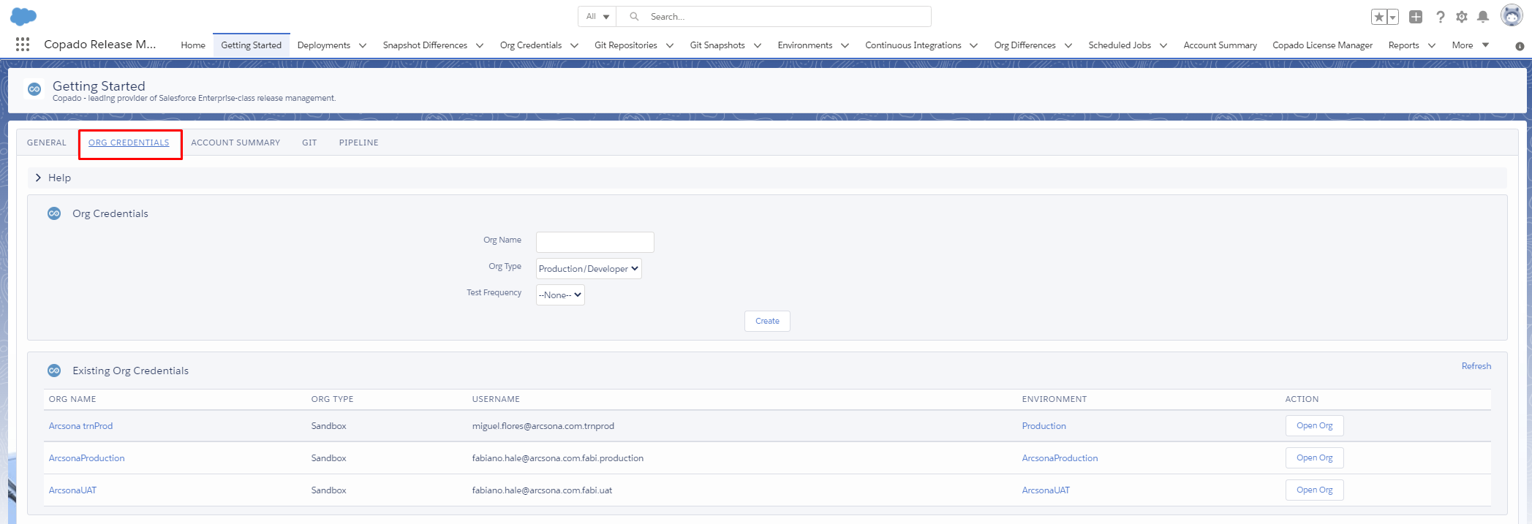
Navigate to the ‘Org Credentials’ tab (image B)

Slide 5
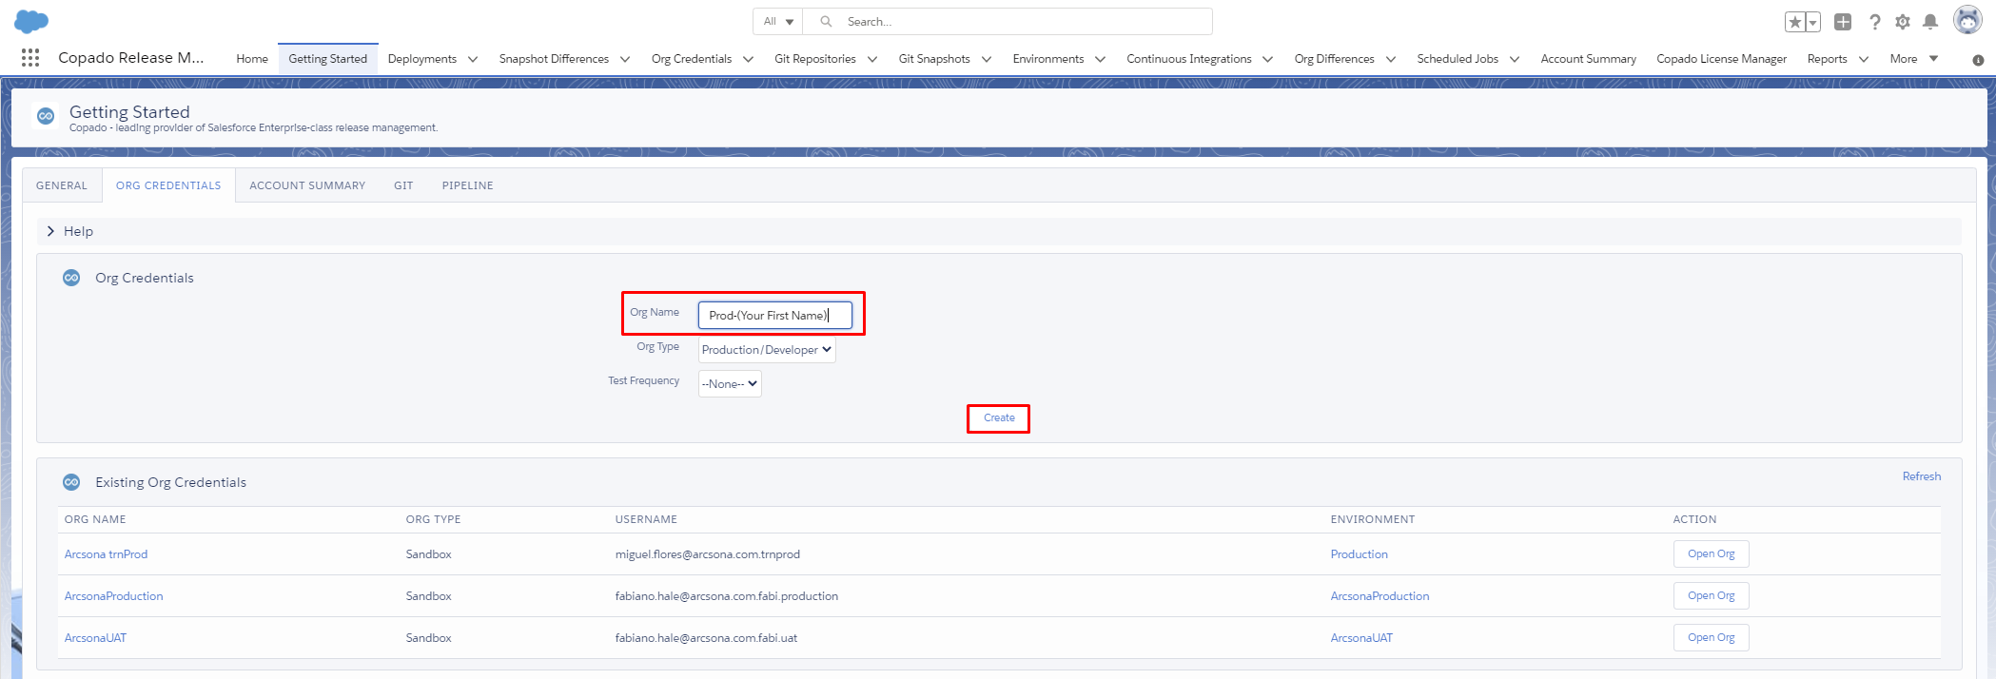
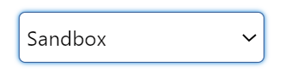
Org Name = Prod-(Your First Name)
Org Type = SANDBOX
Once you are done, click on ‘Create’ (image C)

Slide 6
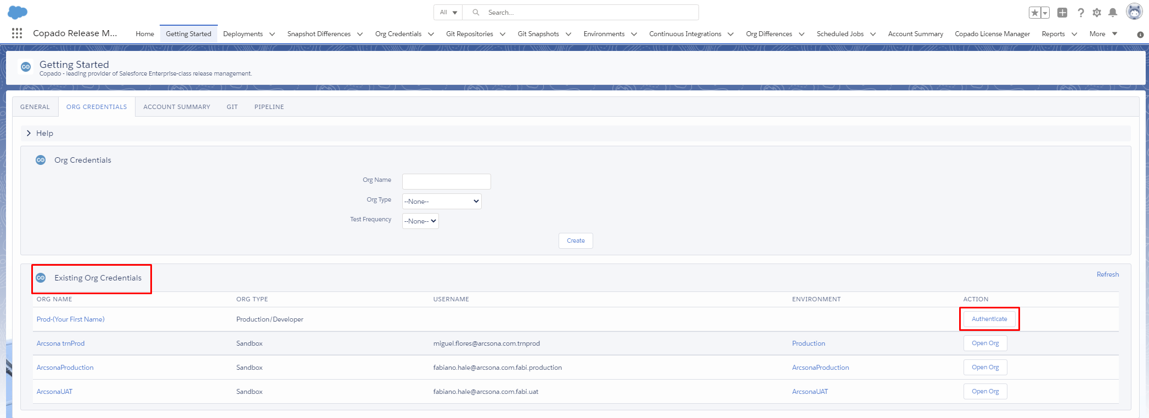
Under the ‘Existing Org Credentials’ section,
Click on ‘Authenticate’ (image D)

Slide 7
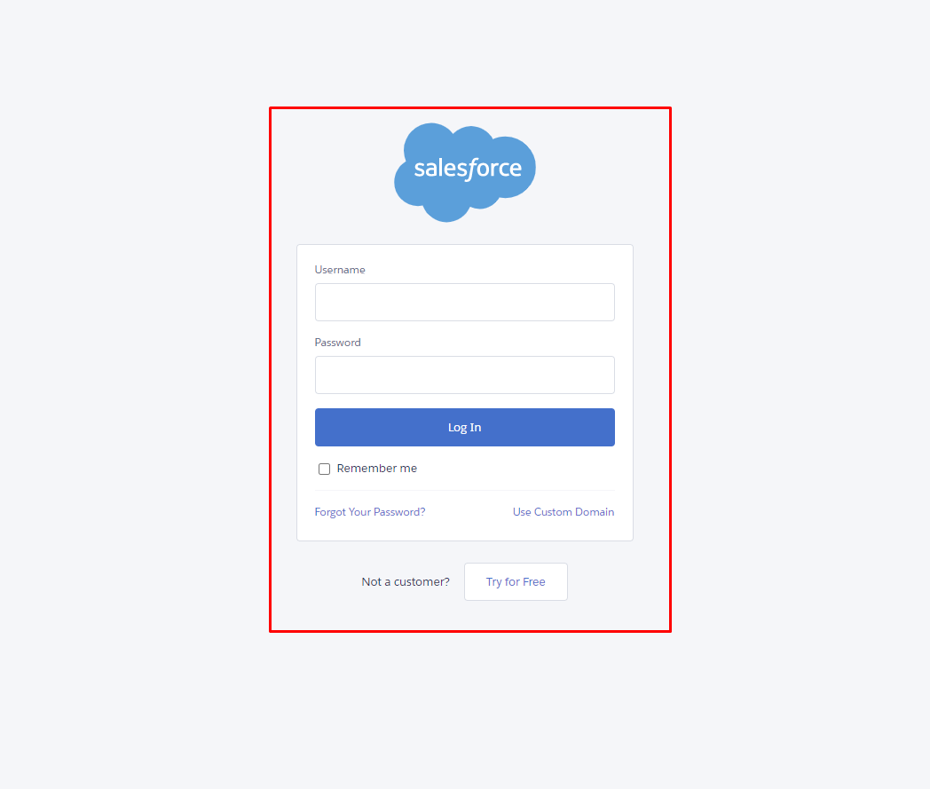
Type in your credentials to the training sandbox (image E)

Slide 8
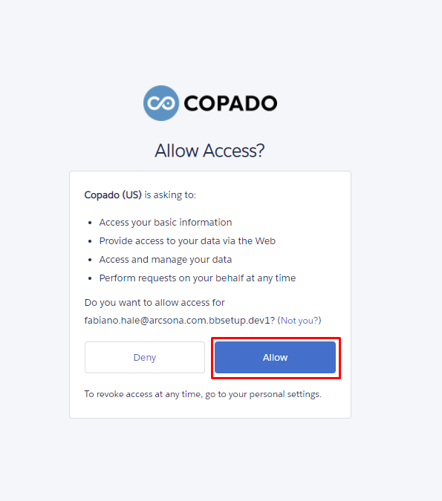
Next, you will be asked to allow Copado to access your Org.
Click on ‘Allow” (image F)

Slide 9
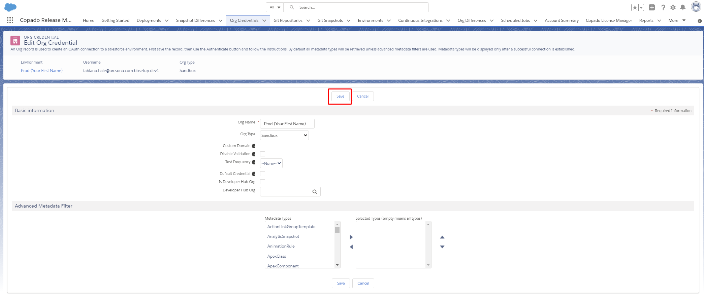
You will be taken to the Org credential record, click on ‘Save’ (image G)

Slide 10
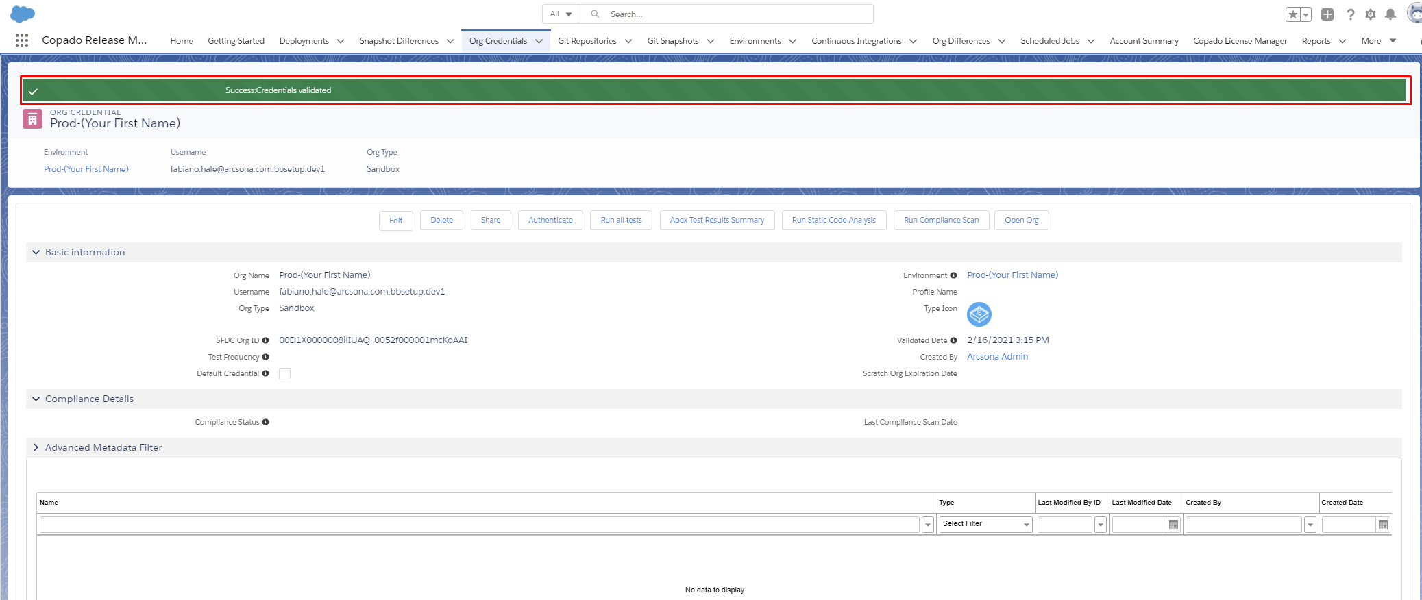
After you select ‘Save’ in the Org Credential Record, validate the
green success message above the record (image H)

Slide 11
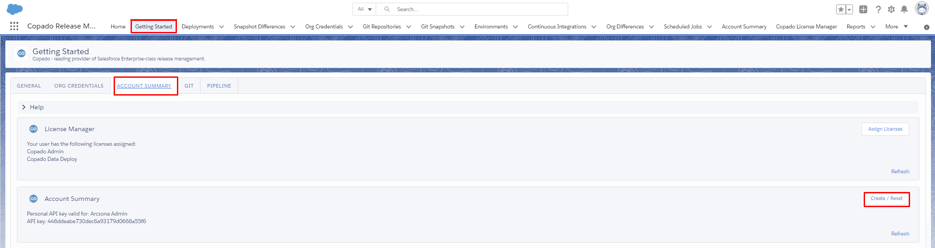
Go back to the ‘Getting Started’ tab, select the ‘Account Summary’ tab
and select ‘Create’ (image I)

Slide 12
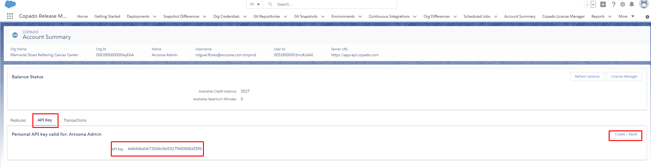
Select ‘API Key’ tab, select ‘Create / Reset’ you should see an API Key (image J)

